Slide 1
Flight Management System

Slide 2
Project Description
Flight Management System primarily deals with management of flights, flight path, flight crew, airports, and passengers. The system provides broad overview of underlying operational factors that influence the airport management.
The database system has the data of all goods and passengers flights, commercial airports and passengers travelling through the airline. We initiated the Flight Management System project for several compelling reasons that align with the evolving needs of the aviation industry and the broader objectives of enhancing operational efficiency, safety, and passenger satisfaction.

Slide 3
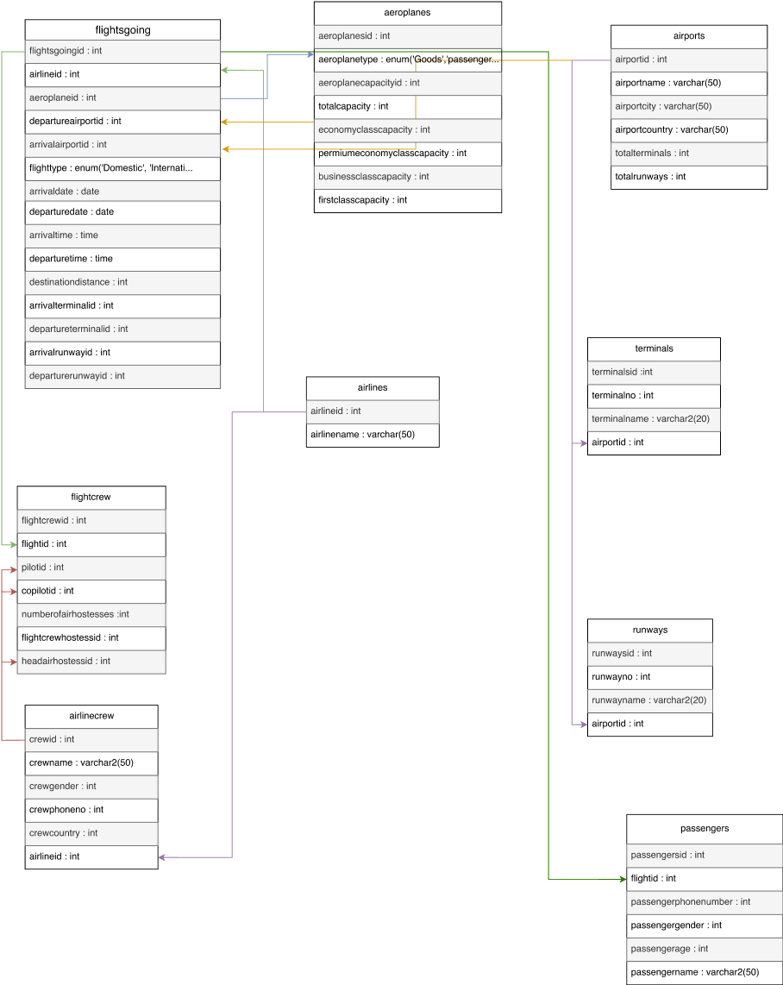
UML Diagram before Normalisation

Slide 4
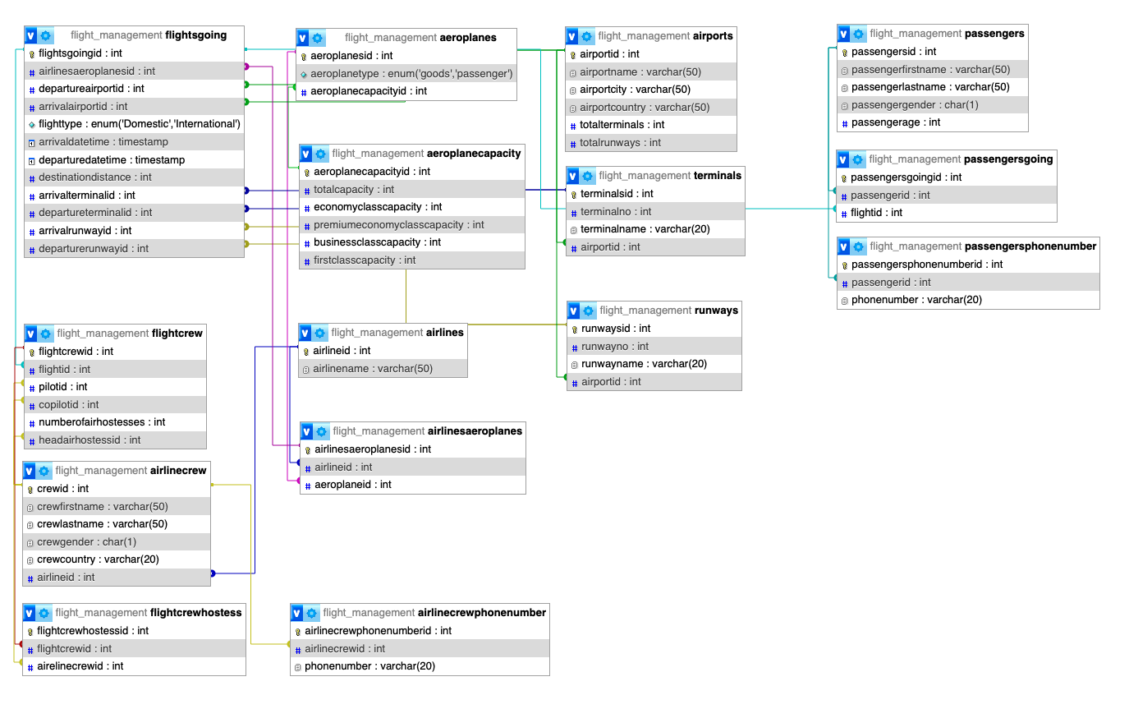
UML Diagram after Normalisation

Slide 5
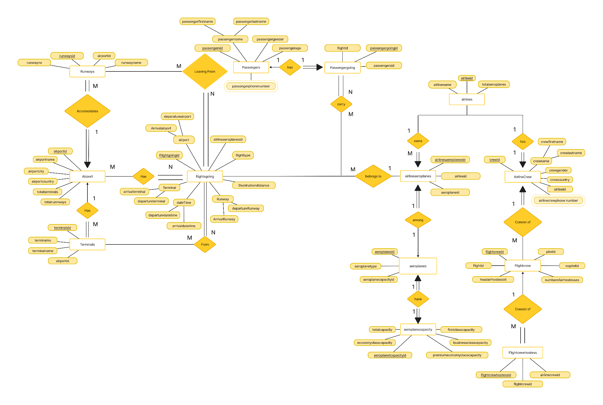
ER Diagram

Slide 6
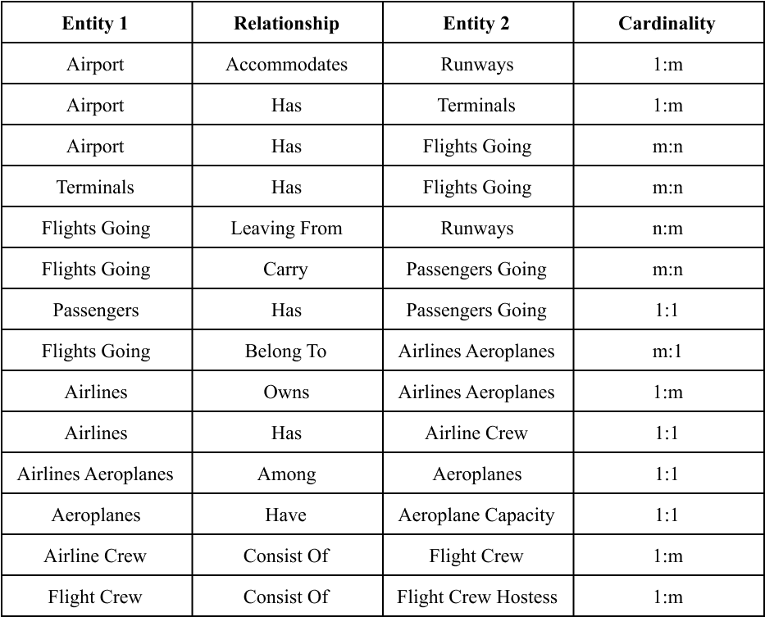
Relationships in ER Diagram

Slide 7
Thank You

